Slide 1


INT201 Decision, Computation and Language
Lecture 10 – Church-Turing Thesis and Limits of Computation
Dr Yushi Li and Dr. Chunchuan Lyu

Slide 2

Recap
Turing Machine
Turing-recognizable (halts on accept) and Turing-decidable (always halts) languages
Multi-tape TM and Nondeterministic TM
Today
Cantor’s Diagonalization Method
Church-Turing Thesis and Universal Turing Machine
Examples of decidable languages
Existence of undecidable language and non-Turing recognizable language

Slide 3
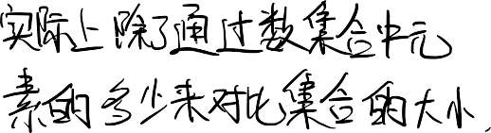

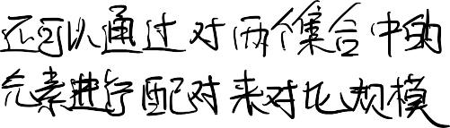


Diagonalization method
Questions:
If we use natural numbers to list natural numbers,
couldn’t we construct a new number by flipping the diagonal and get a new
number that is not in the natural number set?
Answer:
True, but the number you get is of infinite length (countable length). All natural numbers are of finite length.
Therefore, you actually constructed a real number.
There is nothing wrong with a real number not in the natural number set.

Slide 4
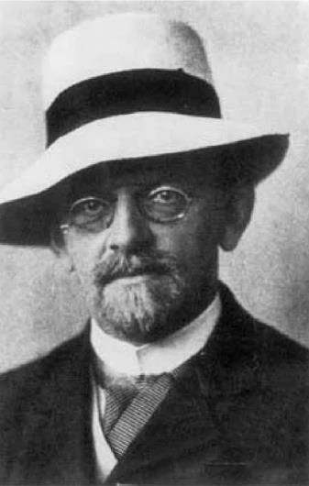

A Brief History of the Limits of Computation
The existence of uncountable sets - Georg Cantor 1874
The diagonal method - Georg Cantor 1891
Is there a set between real and natural numbers？ – David Hilbert 1900
Prove axioms of arithmetic are consistent – David Hilbert 1900
We must know. We shall know – David Hilbert 1930
The existence of non-provable & non-disprovable statements
Consistency of powerful system cannot be proved within itself - Kurt Gödel 1931
Whether a statement is provable from axioms is not Turing-decidable – Church & Turing 1936
Is there a set between real and natural numbers is independent of ZFC –Gödel 1940 & Cohen 1963
The Church–Turing Thesis: every effectively calculable function (effectively decidable
predicate) is general recursive (Turing computable)– Stephen Kleene 1952
David Hilbert 1862-1943
German
Mathematician

Slide 5
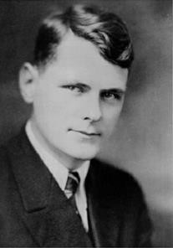
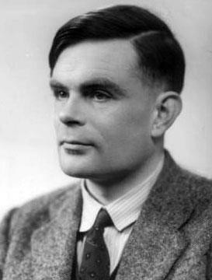
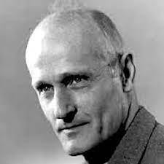
=
The Church–Turing Thesis
Algorithm
Turing
machine
Intuitive
Alonzo Church 1903 - 1995
How to prove this? Is it even possible?
Formal
Alan Turing
1912–1954
How to disprove this? Is it even possible?
Stephen Kleene 1909 -1994

Slide 6




















The Church–Turing Thesis
Existence of non Turing-recognizable languages.
Proposition: Each Turing machine can be encoded by a distinct, finite
string of 1’s and 0’s and some finite special symbols.
Proof : encode TM as 7 tuple with special symbols, and encode alphabets in binary. Transitions can be encoded as a sequence of 5 tuples (state,tape,new state, new tape, left or right).
It is of critical importance that each single Turing machine is described in finite length.
Corollary: There are countable many Turing machines.

Slide 7
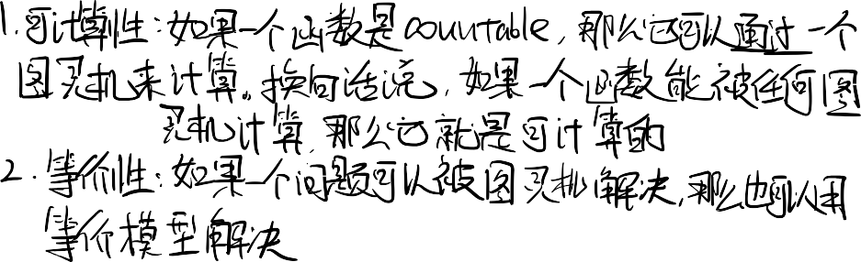

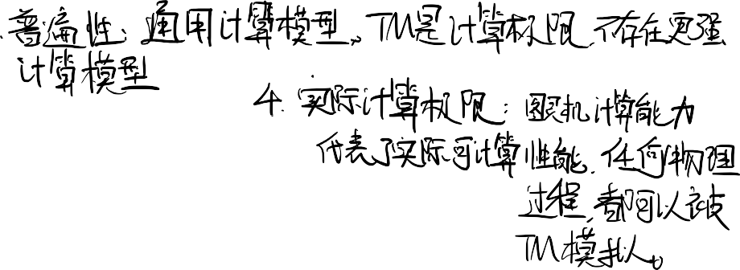


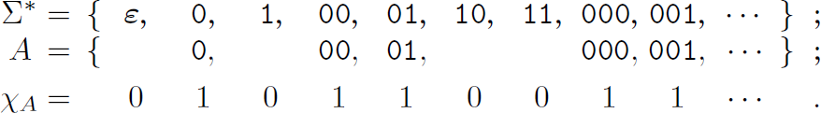


The Church–Turing Thesis
Existence of non Turing-recognizable languages.
Corollary: There are countable many Turing machines.
Proposition: There are uncountable many languages.
Proo
f:
There is a bijection between languages and countable binary sequences
that is uncountable by the diagonalization method.
Corollary There exists non Turing-recognizable languages.
Is there another languages between all languages and Turing-recognizable languages?
This is equivalent to the existence of a set number natural numbers and
real numbers. So, it is independent of ZFC
7

Slide 8

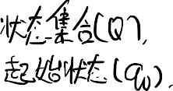
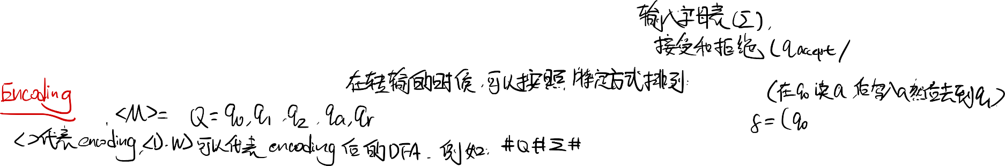






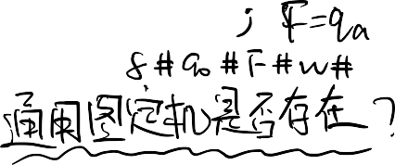


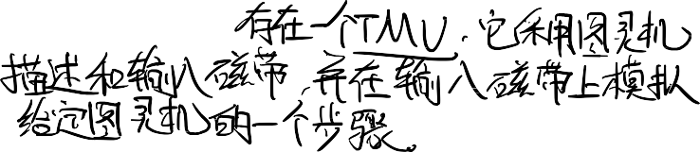
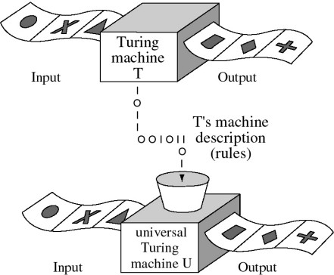

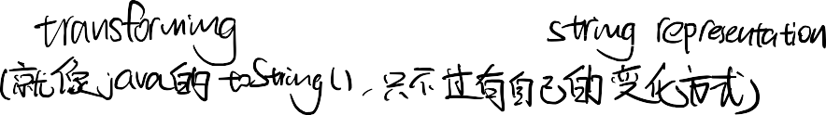
The Church–Turing Thesis
Universal Turing Machine
Theorem Universal Turing Machine Exists
There exists a TM U that takes a Turing machine description and input tape and
simulate one step of that given Turing machine on the input tape.
Input to TM U is in the format
<M,w> where
M is the TM description, and
w the (converted) input.
The smallest UTM has 2 states and 3 symbols - Alex Smith, a 20-year-old undergraduate from Birmingham 2007

Slide 9
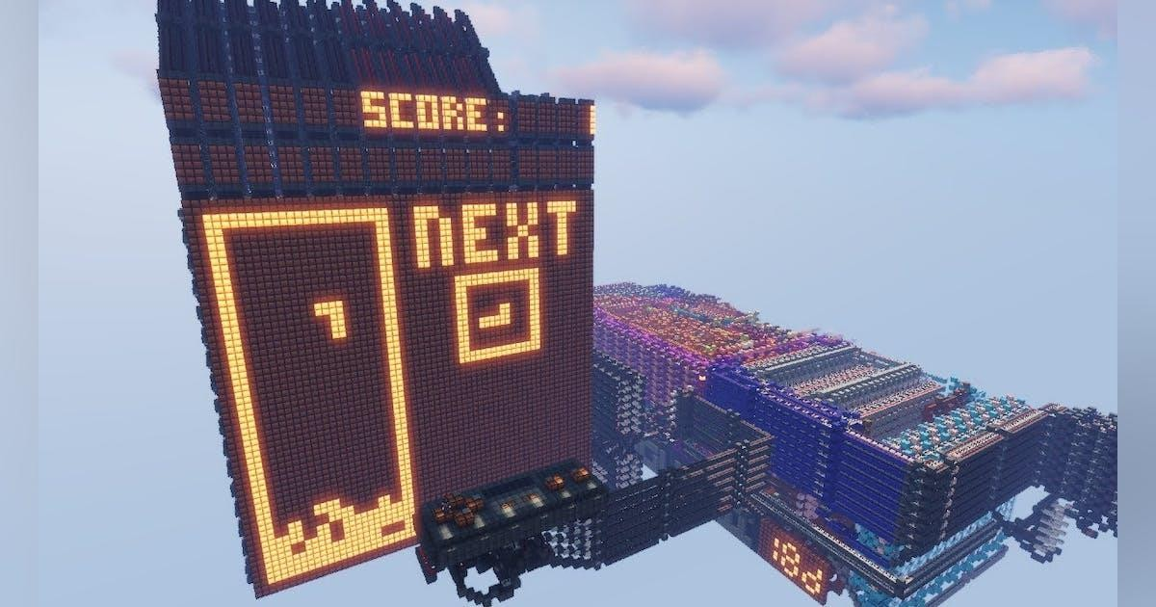
Church-Turing Thesis
To prove the thesis, we need to show that the world is Turing computable.
The Minecraft world is simulated on digital computer, and we can build computer inside Minecraft. Hence, in the Minecraft world, computation is equivalent to Turing computable.

Slide 10
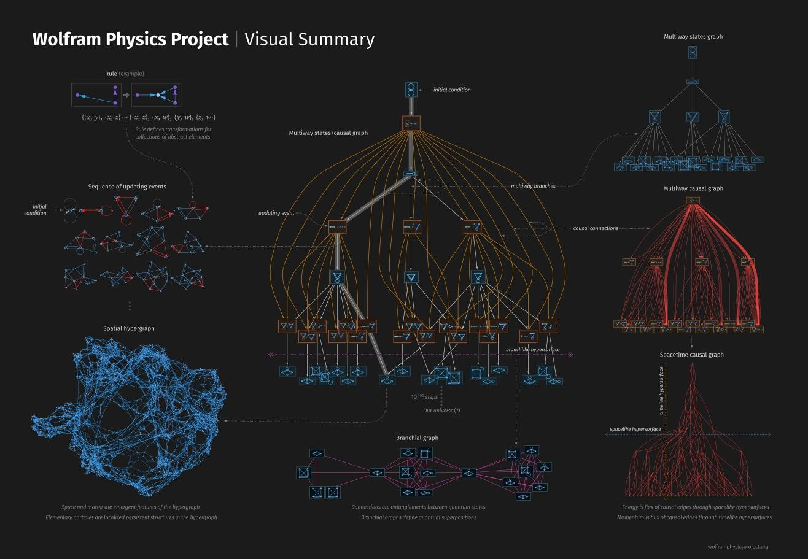
Church-Turing Thesis
To prove the thesis, we need to show that the world is Turing computable.
Stephen Wolfram has a hyper graph replacement based
formalism for a theory of everything.
If a theory like this is true, then the world is Turing computable. (how can we know?)
https://writings.stephenwolfra m.com/2020/04/finally-we- may-have-a-path-to-the- fundamental-theory-of- physics-and-its-beautiful/

Slide 11


Church-Turing Thesis
To prove the thesis, we need to show that the world is Turing equivalent up to
manipulating a sequence of finite symbols.
Q: but we live in a quantum universe, clearly there are things that cannot be captured by discrete symbols.
A: Turing machine examines a finite sequence of symbols, it cannot
represent all mathematical object.
The question is that given your extra power in the physical world, can you do more in terms of recognizing a finite sequence of symbols?
In fact, quantum Turing machine is equivalent to Turing machine.
Also, Church-Turing thesis is not about time complexity.

Slide 12




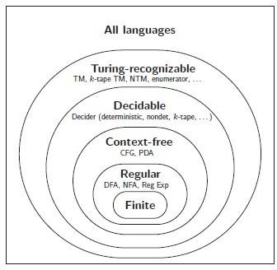
Church-Turing Thesis
To disprove the thesis, we need to show that there is a non Turing-
recognizable/decidable language that can be recognized or decided by a physical device.
This process is how we find PDA on top of DFA, and TM on top of PDA.
Can we draw another circle? With possible overlap
If we can find a machine that manipulate the tape in a way that TM cannot simulate in finite time, we can construct a non Turing-recognizable language.

Slide 13
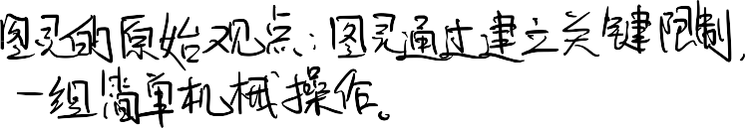

Church-Turing Thesis
Turing’s original argument where Turing shows that human computation can be reduced to a finite set of simple mechanical operations by establishing key limitations:
Finite symbols: Humans can only write/recognize a limited set of distinct
symbols
Limited observation: We can only view a bounded number of squares at once
Local movement: We can only move our attention within a fixed distance
Direct manipulation: We must observe a square to modify it
Deterministic behavior: Actions are determined by current observations and
mental state
Finite mental states: The number of possible mental states is bounded
Elementary operations: All computation reduces to simple atomic actions (changing mental state, moving attention, or modifying one symbol)

Slide 14
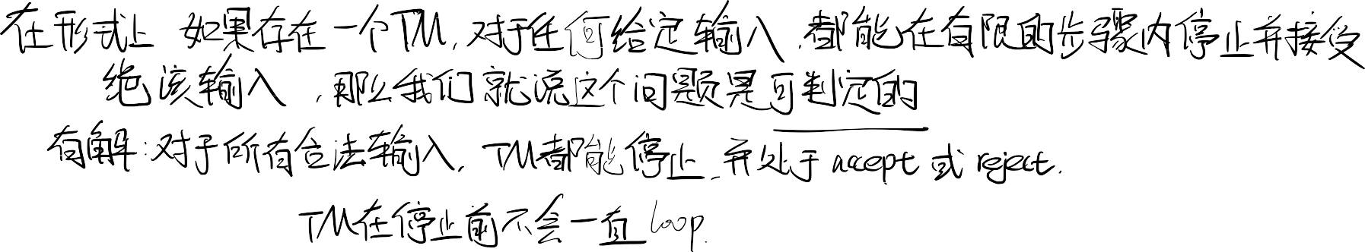




Decidability
Given a language L whose elements are pairs of the form (B, w), where
B is some computation model (e, g. DFA, NFA…).
w is a string over the alphabet Σ.
The pair (B, w) ∈ L if and only if w ∈ L(B).
Since the input to computation model B is a string over Σ, we must encode the pair (B, w) as a string.

Slide 15

Acceptance problem for computation model
Decision problem: Dose a given model accept/generate a given string w?
Instance B, w is the encoding of the pair (B, w).
Universe Ω comprises every possible instance:
Ω = { B, w | B is a model and w is a string}
Language comprises all “yes” instances
L = { B, w | B is a model that accept w} ⊆ Ω

Slide 16
Acceptance problem for Language L_{DFA}
Decision problem: Dose a given DFA B accept a given string w?
Instance B, w is the encoding of the pair (B, w).
Universe Ω comprises every possible instance:
Ω = { B, w | B is a DFA and w is a string}
Language comprises all “yes” instances
L = { B, w | B is a DFA that accept w} ⊆ Ω

Slide 17
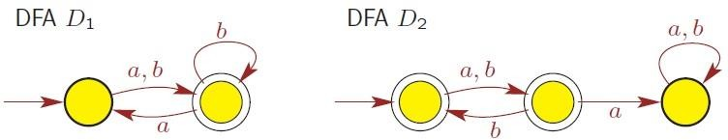

Acceptance problem for Language L_{DFA}
Example

Slide 18













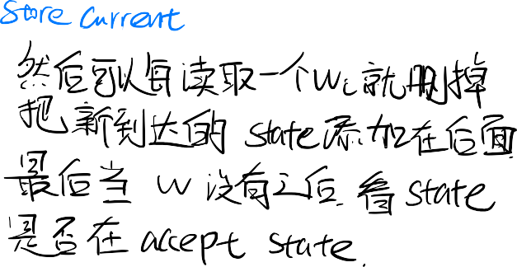
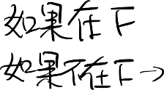




The Language L_{DFA} is decidable
L_{DFA} = { B, w | B is a DFA that accept w} ⊆ Ω
Ω = { B, w | B is a DFA and w is a string}
To prove L_{DFA} is decidable, we need to construct TM M that decides L_{DFA.}
For M that decides L_{DFA} :
take B, w ∈ Ω as input
halt and accept if B, w
halt and reject if B, w
^{∈ L}DFA
^{∈ L}DFA

Slide 19










The Language L_{DFA} is decidable
Proof
Basic idea:
On input B, w ∈ Ω, where
B = (Σ, Q, δ, q₀, F) is a DFA
w = w₁w₂ · · ·w_{n} ∈ Σ∗ is input string to process on B.
Check if B, w is “proper” encoding. If not, reject
Simulate B on w based on:
q ∈ Q, the current state of B
i ∈ {1, 2, …, |w|}, the pointer that illustrates the current position in w.
q changes in accordance with w_{i} and the transition function δ(q, w_{i}).
3. If B ends in q ∈ F, then M accepts; otherwise, reject.

Slide 20



















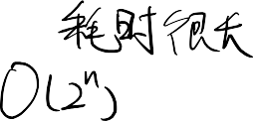




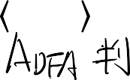


The Language L_{NFA} is decidable
Decision problem: Dose a given NFA B accept a given string w?
L_{DFA} = { B, w | B is a NFA that accept w} ⊆ Ω Ω = { B, w | B is a NFA and w is a string}
Proof
On input B, w ∈ Ω, where
B = (Σ, Q, δ, q₀, F) is a NFA
w ∈ Σ∗ is input string to process on B.
Check if B, w is “proper” encoding. If not, reject.
Transform NFA B into an equivalent DFA C.
Run TM for L_{DFA} on input C, w
If M accepts C, w , accept; otherwise, reject.

Slide 21





L_{CFG} are decidable
Decision problem: Dose a CFG G generate a string w ?
L_{CFG} = { G, w | G is a CFG that generates string w} ⊆ Ω Ω = { G, w | G is a CFG and w is a string}
G, w ∈ L_{CFG} if G generates w, w ∈ L(G)
G, w ∉ L_{CFG} if G dosen’t generate w, w ∉ L(G)

Slide 22
CFGs are decidable
Recall
A context-free grammar G = (V, Σ, R, S) is in Chomsky normal form if each rule is of the form
A → BC or A → x or S → ε
variable A ∈ V
variables B,C ∈ V − {S}
terminal x ∈ Σ.
Every CFG can be converted into Chomsky normal form CFG G in Chomsky normal form is easier to analyze.
∗
for any string w ∈ L(G) with w ≠ ε by derivation S ֜ w takes exactly 2|w| − 1 steps. Base case S → w where w is singular letter takes 1 step. Additional one step to increase number of variables and another to realize it.
ε ∈ L(G) if G includes rule S → ε.

Slide 23

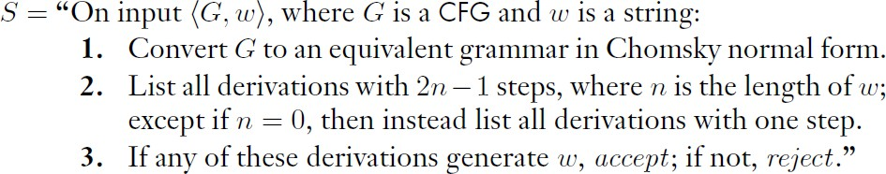
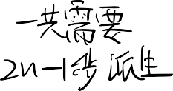
CFGs are decidable
Proof
Or just run CYK algorithm to find all derivations

Slide 24

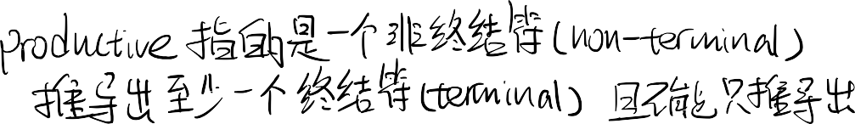
















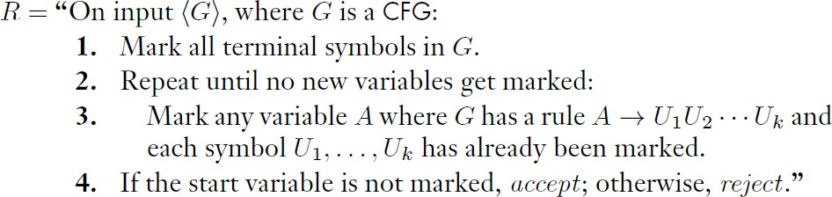





Emptiness of CFLs are decidable
E_{CFG} = { G | G is a CFG and L(G)=∅} Proof idea:
Rule set is finite, and try exhaustively build parse tree from all potential list of terminals, and check whether we can reach the start symbol.
Proof

Slide 25
The Language L_{TM} is Turing-recognizable
L_{TM} = { M, w : M is a Turing machine that accepts the string w}
If M accepts w, then M, w ∈ L_{TM}
If M doesn’t accept w (reject or loop), then
M, w ∉ L_{TM}
The language L_{TM} is Turing-recognizable.
Proof:
A universal Turing machine U simulates M on w
If M accepts w, simulation will halt and accept
If M doesn’t accept w (reject or loop), TM U either reject or loops.

Slide 26





The Language L_{TM} is undecidable
The language L_{TM} is undecidable.
L_{TM} = { M, w : M is a Turing machine that accepts the string w}
The problem is that we don’t really know whether the universal Turing machine will halt or not. Unlike all the machines we saw earlier, TM might run forever.
Intuitively, it looks hard to find a decider for this problem.
However, to show this is indeed undecidable is not trivial.

Slide 27

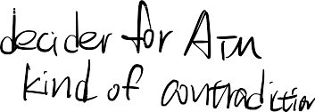


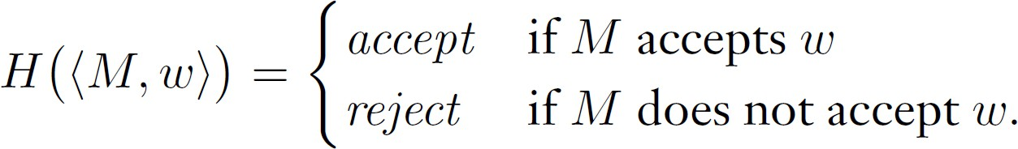
The Language L_{TM} is undecidable
The language L_{TM} is undecidable.
L_{TM} = { M, w : M is a Turing machine that accepts the string w}
Proof:
We will prove by contradiction and use the diagonalization method. We assume such a decider H exists, then show that the set of Turing machine is uncountable.

Slide 28
The Language L_{TM} is undecidable
L_{TM} = { M, w : M is a Turing machine that accepts the string w}
Proof:
We will prove by contradiction and use the diagonalization method. We assume such a decider H exists, then derive a contradiction in terms of the countability of Turing machines.
As the set of Turing machine is known to be countable, let’s index them by 𝑀_{𝑖}.
Now, it makes sense to ask the answer to 𝐻(< 𝑀_{𝑖}, < 𝑀_{𝑗} >>) that is whether 𝑀_{𝑖} accepts
the description of 𝑀_{𝑗} as input.

Slide 29
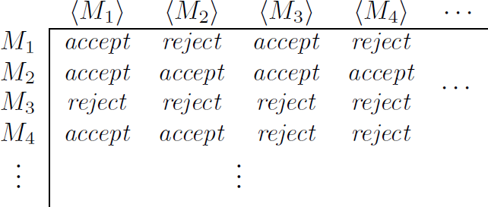
The Language L_{TM} is undecidable
L_{TM} = { M, w : M is a Turing machine that accepts the string w}
Proof continue:
As the set of Turing machine is known to be countable, let’s index them by 𝑀_{𝑖}.
Now, it makes sense to ask the answer to 𝐻(< 𝑀_{𝑖}, < 𝑀_{𝑗}
the description of 𝑀_{𝑗} as input. We have this table
>>) that is whether 𝑀_{𝑖} accepts
Can we construct a Turing machine that is not in this list by the diagonalization method?
So that we will show the set of Turing machines is not countable, and we have a contradiction.

Slide 30

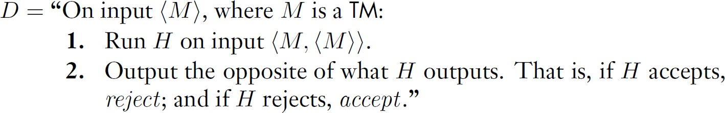
The Language L_{TM} is undecidable
L_{TM} = { M, w : M is a Turing machine that accepts the string w}
Proof continue:
We know that this process will halt, as H is a decider.
Now, we construct a Turing machine D that flips the diagonal (saying flipping is not enough, as the flipping needs to be done by a Turing machine):
Clearly, D is a decider and hence a Turing machine. It should be in the list.
Importantly, if H is not a decider, step 1 could loop forever, and D loop forever.
Therefore, D does not really flip the diagonal.

Slide 31
The Language L_{TM} is undecidable
L_{TM} = { M, w : M is a Turing machine that accepts the string w}
Proof continue:
Clearly, D is a decider and hence a Turing machine. It should be in the list.
However, we know that by the diagonal flipping, it is not on the list as at least one value differs, and D is not in this list. It must be the case that Turing machines are not countable (so, we cannot do the numbering)
This is a contradiction.

Slide 32



The Language L_{TM} is undecidable
L_{TM} = { M, w : M is a Turing machine that accepts the string w}
Alternative Proof:
Another common presentation of this proof is to ask directly: Should D accepts <D>?
If D accepts <D>, in step 1 H accepts <D,<D>>, then in step 2 D rejects the <D>. If D rejects <D>, in step 1 H rejects <D,<D>>, then in step 2 D accepts the <D>. We have a contradiction.

Slide 33
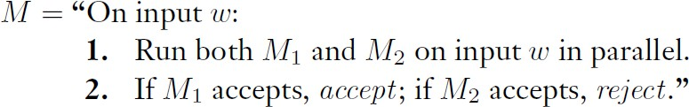
Instance of non Turing-recognizable languages.
Theorem: A language A is decidable if and only if it is Turing-recognizable and co-
Turing-recognizable.
Proof: the only if part is simple, a decider always halts, and the decider accepts the language. For the complement of the language, a Turing machine accepts when the decider rejects and vice versa.
Now, for the if part, if both 𝐴 and 𝐴^{ҧ} are Turing-recognizable, we let 𝑀₁
be the recognizer for A and 𝑀₂ be the recognizer for 𝐴^{ҧ} . The following Turing machine M is a decider for A.
Corollary L_{TM} is not Turing-recognizable.

Slide 34
Quick review
Cantor’s Diagonalization Method
Church-Turing Thesis and Universal Turing Machine
Examples of decidable languages
Existence and instance of undecidable language and non-Turing recognizable language

Slide 35




THANK YOU
35

